Slide 1
TABLEAU PROJECT
DASHBOARDING ON UDEMY COURSES
SUBMITTED BY:
SNEHA SINGH

Slide 2
PROBLEM STATEMENTS
Course_id
Course_title
Price
Num_Subscribers
Num_reviews
Num_lectures
Level
Content_duration
Published_timestamp
Subject
URL

Slide 3
Executive Summary
This project is dashboarding on topic udemy course.The data set contain the problem statement like course id,course title,subject,price,url.each category the data set containing the detail according to their name specified.
VIDEO LINK: https://drive.google.com/file/d/1f7hVoPTRdX_HFxgO24VY9WHUollwipgE/view?usp=sharing

Slide 4
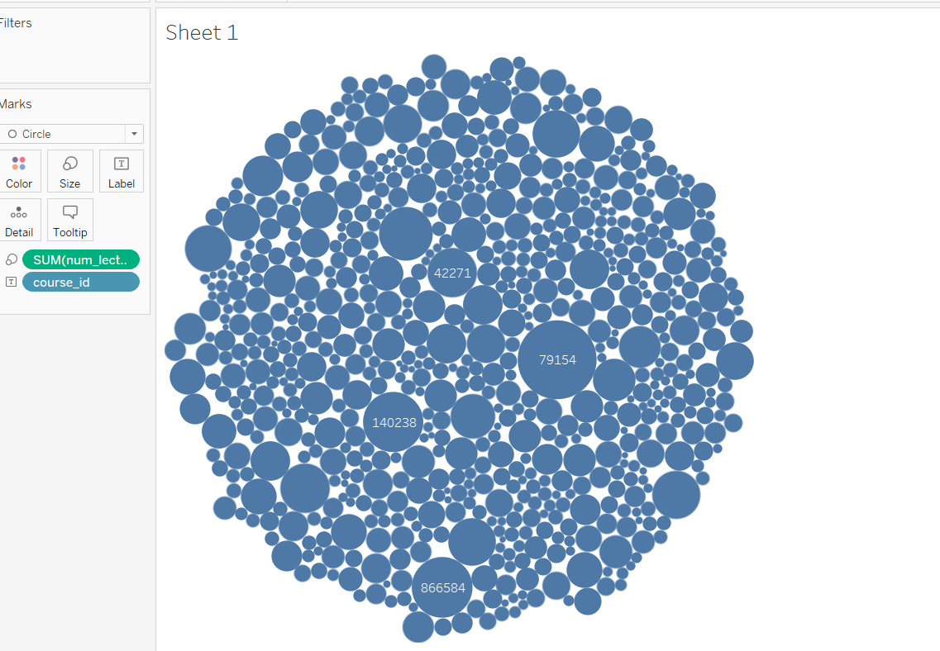
Basic Analysis
This graph shows the course content of web development having more number of lectures.

Slide 5
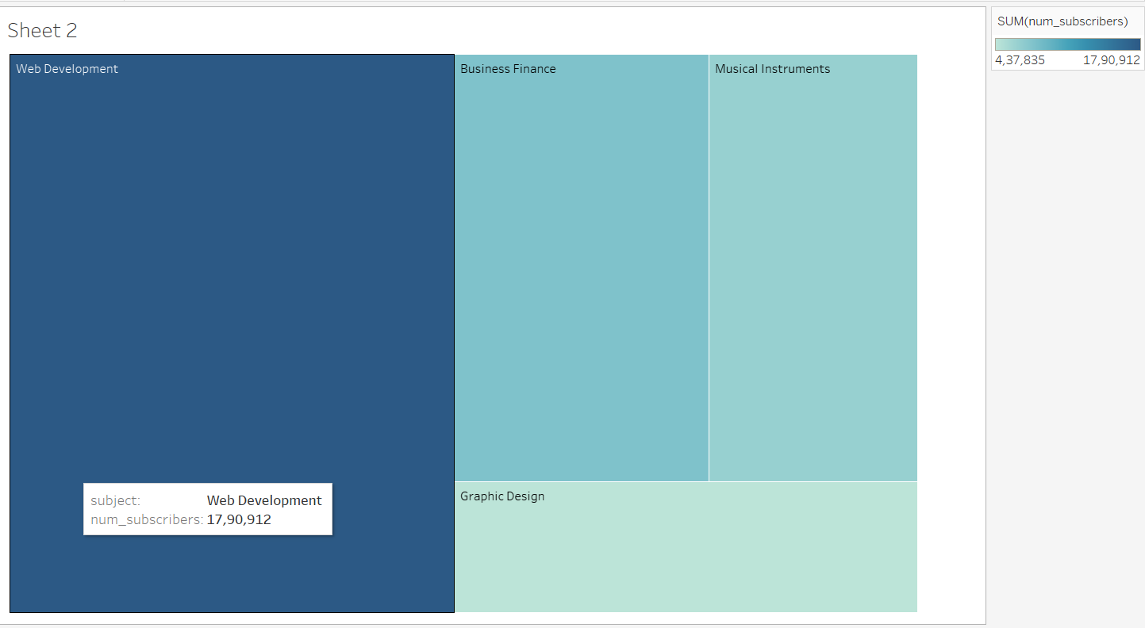
This graph shows that web development is having more number of subscribers.

Slide 6
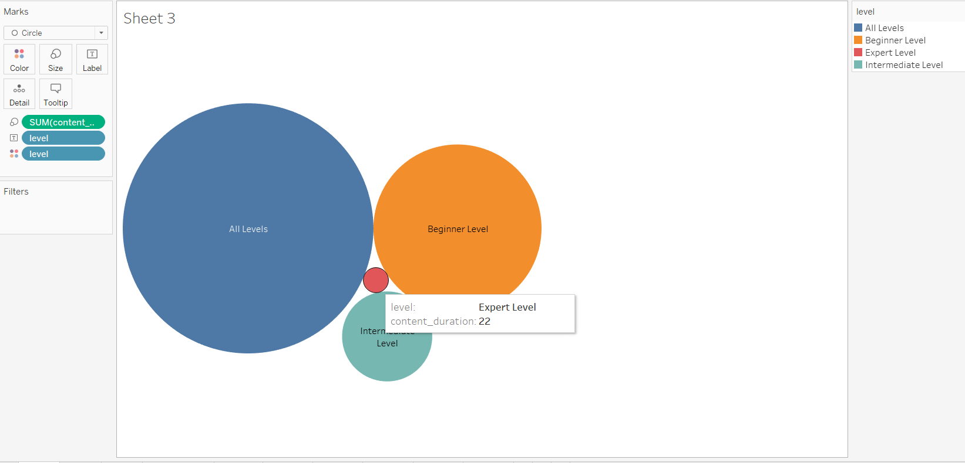
This graph shows that the course of expert level is less in comparision of all available level in udemy course .

Slide 7
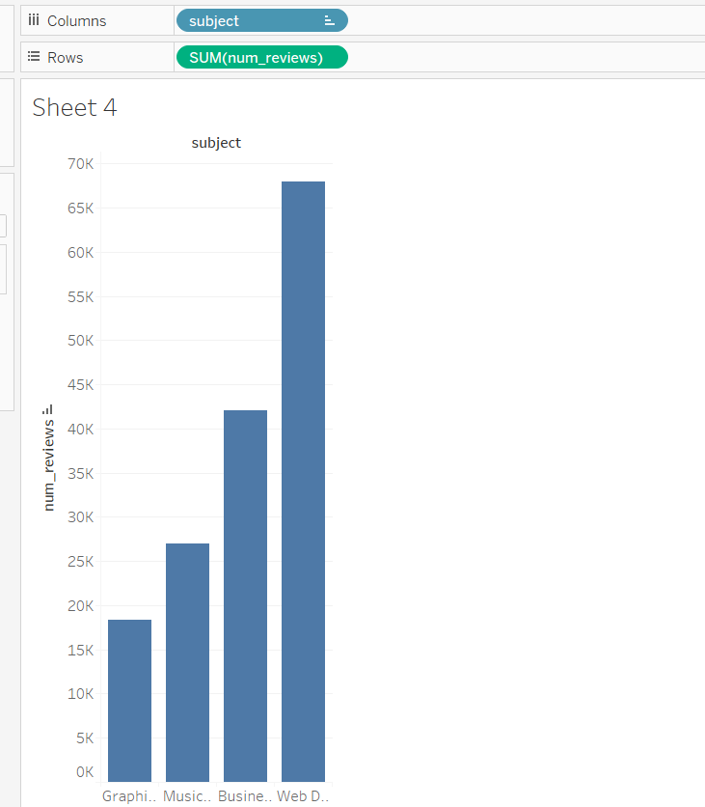
This shows the reviews of all courses inudemy course.

Slide 8
CONCLUSION
This project is about all the courses available on udemy .after comparing all data of different courses of udemy I conclude that the most course is available is of subject web development.web Development is having large number of subscriber in comparison of all other subjects available on udemy.In this Expert level is less as comparision of all other level available on Udemy.

Slide 9
THANK YOU

